Slide 1


General course
2022-2023
Database
Queries
Serhat Erdogan

Slide 2
Goals of this lesson
Student can create a table using sql queries.
Student can input data into a table using sql queries.
Student can make basic queries using select, from, where,..

Slide 3
Content table
What is SQL?
How to create Table
How to insert data into table
Update data in table
Select, from, where,…

Slide 4
SQL
SQL (often pronounced like “sequel”) stands for Structured Query Language, and it's used when companies have a ton of data that they want to manipulate. The beauty of SQL is that anyone working at a company that stores data in a relational database can use it. (And chances are, yours does.)
For example, if you work for a software company and want to pull usage data on your customers, you can do that with SQL. If you’re helping develop a website for an ecommerce company that has data about customer purchases, you can use SQL to find out which customers are purchasing which products. Of course, these are just a few of many possible applications.

Slide 5
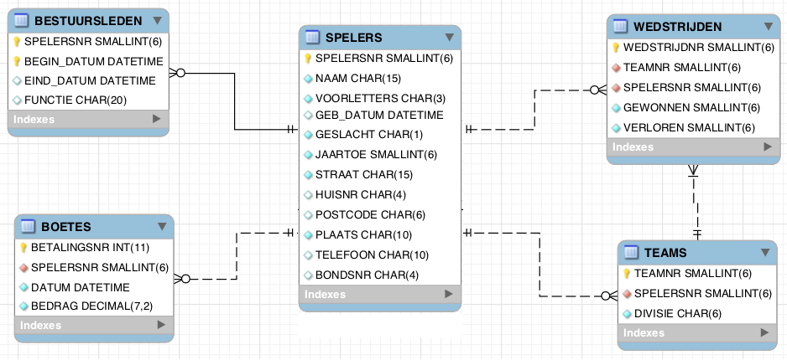
ERD

Slide 6
Create Table
Define name and columns for each column, define datatype, define primary key and if needed foreign key.
CREATE TABLE `TEAMS` (
`TEAMNR` int(6) NOT NULL,
`SPELERSNR` int(6),
`DIVISIE` varchar(6),
primary key(`TEAMNR`),
Foreign key(`SPELERSNR`) references spelers(`SPELERSNR`)
)

Slide 7
Insert data
The INSERT INTO statement is used to insert new records in a table.
INSERT INTO teams (TEAMNR, SPELERSNR, DIVISIE)
VALUES (1 , 6 , "ere"),
(2 , 27 , "tweede");

Slide 8
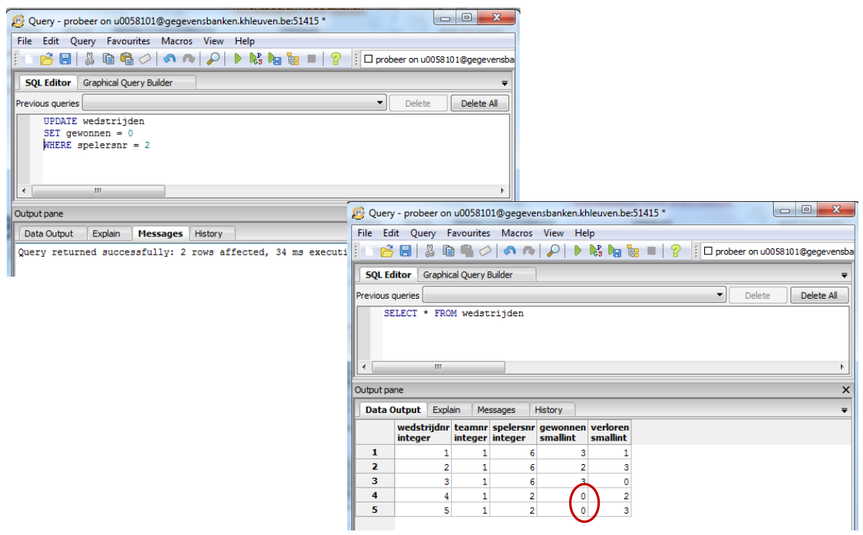
Update data
The UPDATE statement is used to modify the existing records in a table.
UPDATE wedstrijden
SET gewonnen = 1
WHERE spelersnr = 2;

Slide 9
Where clause
The WHERE clause is used to filter records. It is used to extract only those records that fulfill a specified condition.

Slide 10
Exercise 1
Create the 2 tables of the following Entity relationship diagram:

Slide 11
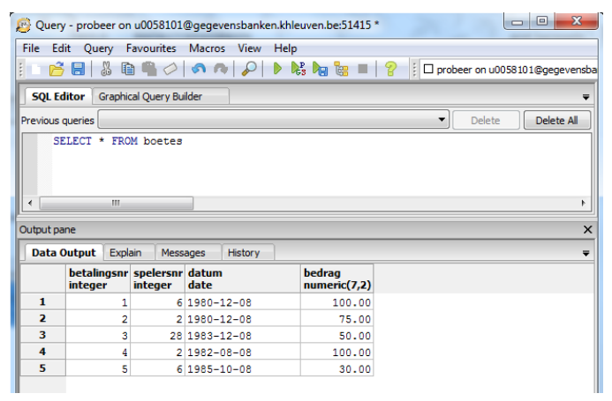
Exercise 2
Increase all fines by 5% (don’t forget to update them back)
Notes:
Update boetes
Set bedrag = bedrag * 1.05

Slide 12
Exercise 3
Increase all fines bigger than 100 by 5%
Notes:
Update boetes
Set bedrag = bedrag * 1.05
Where bedrag > 100

Slide 13
Query
Too learn how to write a SQL query, let's use the following example:
Who are the players who live in Den Haag and were born in 1963 organized in alphabetical order?

Slide 14
SELECT
SELECT chooses the fields (columns) that you want displayed in your chart. This is the specific piece of information that you want to pull from your database. In the example above, we want to find the people who fit the rest of the criteria.
SELECT SPELERSNR, NAAM;

Slide 15
FROM
FROM pinpoints the table that you want to pull the data from. Because we're looking for players specifically, we'll pull data from that specific table.
SELECT SPELERSNR, NAAM
FROM spelers;

Slide 16
WHERE
WHERE allows you to filter a query to be more specific. In our example, we want to filter our query to include only spelers with who live in Den Haag and were born in 1963. Let’s start with the Den Haag filter:
SELECT SPELERSNR, NAAM
FROM spelers
WHERE PLAATS = 'Den Haag';

Slide 17
BETWEEN
Besides equals (=), BETWEEN is another operator you can use for conditional queries. A BETWEEN statement is true for values that fall between the specified minimum and maximum values.
In our case, we can use BETWEEN to pull records from a specific year, like 1963. Here’s the query:
SELECT SPELERSNR, NAAM
FROM spelers
WHERE GEB_DATUM BETWEEN ‘1963-01-01’ AND ‘1963-12-31’ ;

Slide 18
OR
OR can also be used with a WHERE statement. With AND, both conditions must be true to appear in results (e.g., Player must live in Den Haag and must be born in 1963). With OR, either condition must be true to appear in results (e.g., Player must live in Den Haag or must be born in 1963).
SELECT SPELERSNR, NAAM
FROM spelers
WHERE PLAATS = 'Den Haag’ OR (GEB_DATUM BETWEEN ‘1963- 01-01’ AND ‘1963-12-31’ );

Slide 19
NOT
NOT is used in a WHERE statement to display values in which the specified condition is untrue. If we wanted to pull up all players who don’t live in Den Haag, we can use the following query:
SELECT SPELERSNR, NAAM
FROM spelers
WHERE NOT PLAATS = 'Den Haag’;

Slide 20
ORDER BY
An ORDER BY clause allows you to sort by any of the fields that you have specified in the SELECT statement. In this case, let's order by player number.
SELECT SPELERSNR, NAAM
FROM spelers
WHERE PLAATS = 'Den Haag’ OR (GEB_DATUM BETWEEN ‘1963- 01-01’ AND ‘1963-12-31’ )
ORDER BY SPELERSNR;

Slide 21
GROUP BY
GROUP BY is similar to ORDER BY, but aggregates data that has similarities. For example, if you have any duplicates in your data, you can use GROUP BY to count the number of duplicates in your fields.

Slide 22
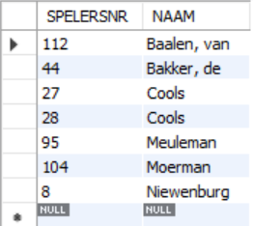
GROUP BY VS ORDER BY
SELECT SPELERSNR, NAAM
FROM spelers
WHERE PLAATS = 'Den Haag’
ORDER BY NAAM;

Slide 23
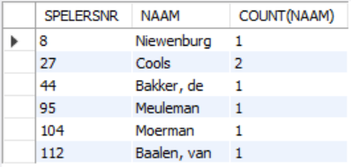
GROUP BY VS ORDER BY
SELECT SPELERSNR, NAAM, COUNT(NAAM)
FROM spelers
WHERE PLAATS = 'Den Haag’
GROUP BY NAAM;

Slide 24
ORDER OF EXECUTION
FROM
SELECT WHERE
GROUP BY
HAVING
ORDER BY

Slide 25
Aggregation functions
AVG: arithmetic average of all values in the set
COUNT: number of values in the set
MAX/MIN: largest / smallest value of all values in the set
SUM: sum of all values in the set
STDDEV: standard deviation of all values in the set
VARIANCE: variance of all values in the set
REMARK: Rows with a null value in the corresponding
set are not counted

Slide 26
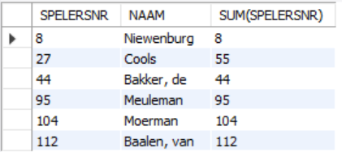
Aggregation functions example SUM
SELECT SPELERSNR, NAAM, SUM(SPELERSNR)
FROM spelers
WHERE PLAATS = 'Den Haag’
GROUP BY NAAM;

Slide 27
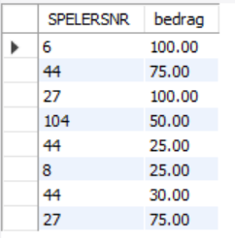
Aggregation functions example MAX/MIN
SELECT SPELERSNR, BEDRAG
FROM boetes;

Slide 28
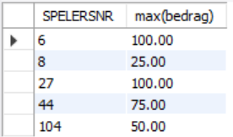
Aggregation functions example MAX/MIN
SELECT SPELERSNR, MAX(BEDRAG)
FROM boetes
GROUP BY SPELERSNR;

Slide 29
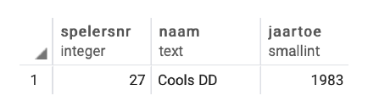
Concatenation ||
SELECT SPELERSNR, concat (naam,” “,voorletters) as Naam,
FROM boetes
WHERE plaats = ‘Zoetermeer’ AND jaartoe <1984

